Slide 1

Real Estate Price Exploration Tool – EDA + visualization to uncover price-driving factors across cities/localities
DS Project Review-2
10-sept-2026
Team Members: Shailaja - 2420030447 Yashaswini - 2420030016 Bhagyalaxmi - 2420030700
 | Under the Guidance of Dr.Sunanda Assistant Professor, Department of Computer Science and Engineering, KLH CSE Bowrampet Campus

Slide 2
Outline of Project Work
Focus
Introduction
Literature Survey
Challenges
Research Objectives
Conclusion & Future Work
References
Publications Details

Slide 3
Problem Statement
Real estate data contains a large number of property records with different features and prices. It is difficult for users to manually identify which factors have the greatest impact on property prices.
There is a need for a simple exploration tool that can analyze real estate data and visually compare prices based on cities, localities, property characteristics, and other important factors.
The proposed system uses EDA and visualization techniques to uncover meaningful patterns and price-driving factors.
Users may struggle to compare a large number of properties manually.
Different locations can show significant variations in property prices.
Raw datasets are difficult to interpret without proper visual analysis.
A visual exploration tool can simplify complex real estate information.

Slide 4
Focus
The project focuses on exploring real estate data using Exploratory Data Analysis (EDA) to understand important patterns and price variations.
It aims to identify the major factors such as location, property area, bedrooms, bathrooms, and property type that influence real estate prices.
The system focuses on comparing property prices across different cities and localities to identify high-value and affordable areas.
Different visualization techniques are used to represent price trends, relationships, distributions, and outliers in an understandable way.
The project analyzes how property characteristics contribute to differences in prices across various locations.
It converts raw real estate data into clear and meaningful visual insights for easier interpretation.
The overall focus is to understand why property prices differ across locations rather than only predicting the final property price.

Slide 5
INTRODUCTION
The real estate market contains properties with different prices across cities and localities.
Property prices are influenced by factors such as location, area, number of bedrooms, bathrooms, property type, and amenities.
Large real estate datasets can be difficult to understand directly.
Exploratory Data Analysis (EDA) helps identify patterns, trends, relationships, and unusual values in the data.
Data visualization makes these insights easier to understand and compare.
This project develops a Real Estate Price Exploration Tool to analyze property prices and identify the major factors influencing them.

Slide 6
Literature Survey
Authors | Title of the Paper | Methodology | Inferences | Limitation/Future work
Zulkifley et al. (2020) | House Price Prediction using a Machine Learning Model: A Survey of Literature | Uses ML techniques such as SVR, ANN and XGBoost for house price prediction. | ML techniques can effectively predict property prices using property-related features. | Mainly focuses on price prediction; data cleaning and quality management are not the main focus.
Ja’afar et al. (2021) | Machine Learning for Property Price Prediction and Price Valuation: A Systematic Literature Review | Reviews different ML techniques used for property price prediction and valuation. | Random Forest and other ML methods show good performance for property price prediction. | Does not provide a complete pipeline combining data cleaning, quality scoring and duplicate detection.
Soltani et al. (2022) | Housing Price Prediction Incorporating Spatio-Temporal Dependency into Machine Learning Algorithms | Uses spatial, temporal and property features with tree-based and ensemble ML models. | Location and time have an important influence on housing prices. | Focuses mainly on prediction and spatial-temporal analysis rather than complete data-quality processing.

Slide 7
CHALLENGES
Handling missing and incomplete values in the real estate dataset.
Removing duplicate and inconsistent property records during preprocessing.
Managing different formats used for property prices, area, and locations.
Comparing properties from cities and localities with different market conditions.
Identifying the most important features from a large number of available attributes.
Detecting and handling extreme values and price outliers.
Creating visualizations that provide useful information without making the dashboard complicated.
Processing large datasets efficiently while maintaining accurate analysis.

Slide 8
Problem Gap Identification
Most existing real estate systems focus mainly on predicting property prices rather than exploring the reasons behind price variations.
Limited attention is given to understanding how different property features affect prices across various locations.
Comparing property prices between different cities and localities can be difficult using raw datasets.
Existing datasets require proper preprocessing and visualization before meaningful insights can be obtained.
There is a need for a combined system that uses EDA and visualization for easy real estate price exploration.
Users need a simple way to filter, compare, and understand large amounts of property information.
The proposed tool addresses this gap by focusing on exploration, comparison, and interpretation of price-driving factors.

Slide 9
Innovation, Creativity, and Novelty
The project focuses on exploring and understanding property prices instead of concentrating only on price prediction.
It provides city-wise and locality-wise analysis to understand how prices vary across different regions.
Multiple EDA techniques are combined with visualizations to provide a complete view of the real estate dataset.
The tool helps analyze the influence of factors such as location, area, bedrooms, bathrooms, and property type.
Users can identify price patterns, trends, relationships, and unusual property values through visual analysis.
The system converts complex real estate data into simple and understandable insights.
Interactive exploration can help users examine different aspects of the dataset according to their requirements.

Slide 10
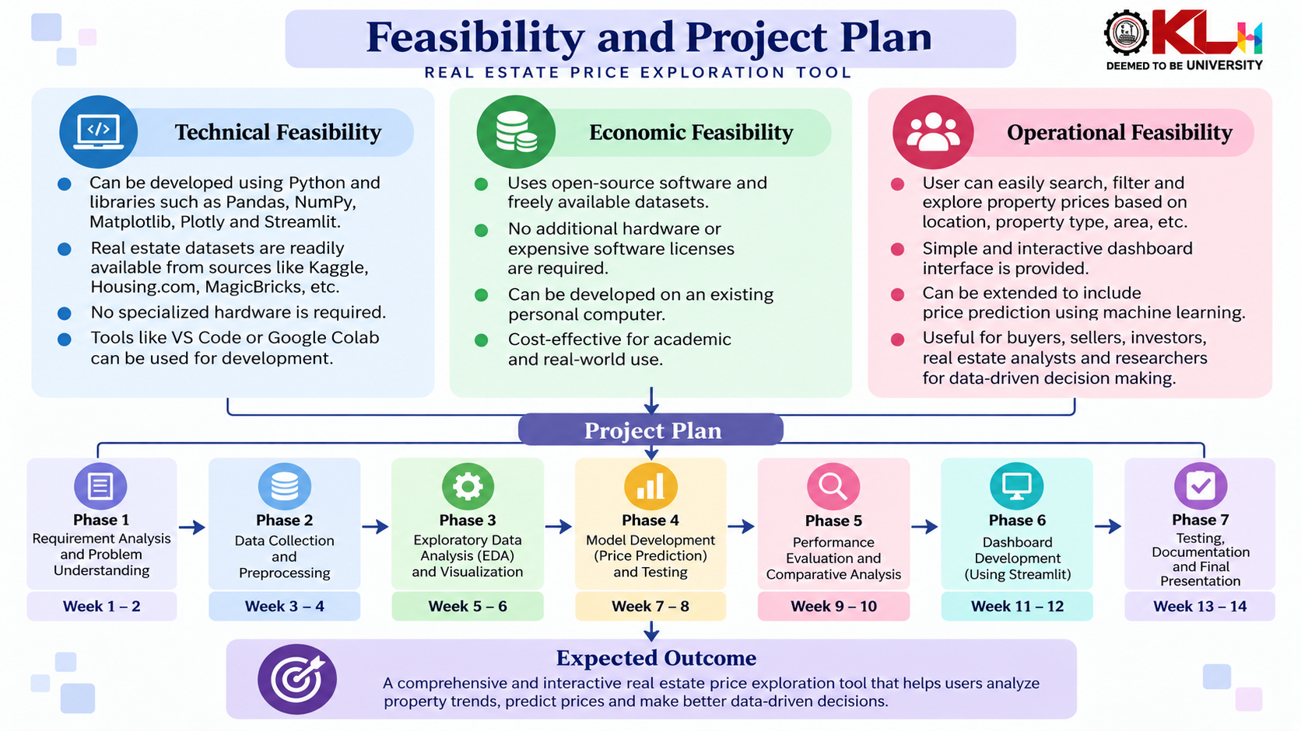
Feasibility and Project Plan

